Slide 1

Presented by Tahsheen Naaz
Team members:
Somayajula surya kamal
S. Chandrika
S. Vamsi
S. Prudhvi Raj

Slide 2
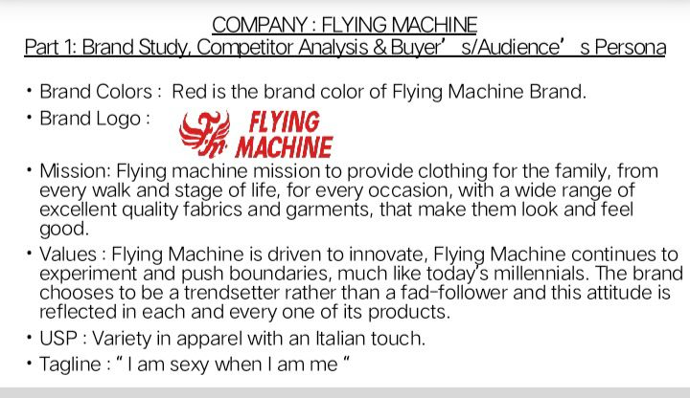

Slide 3


Slide 4
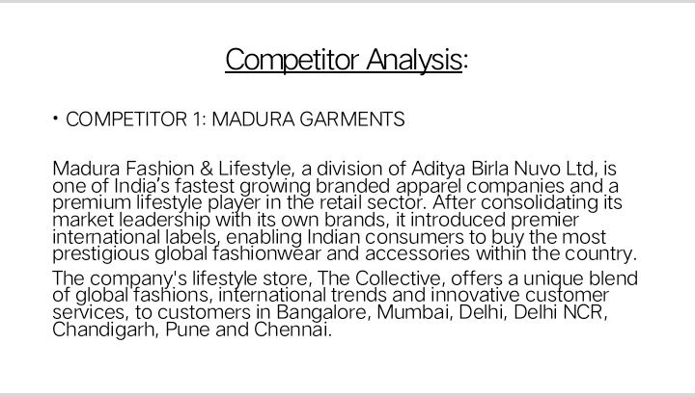

Slide 5
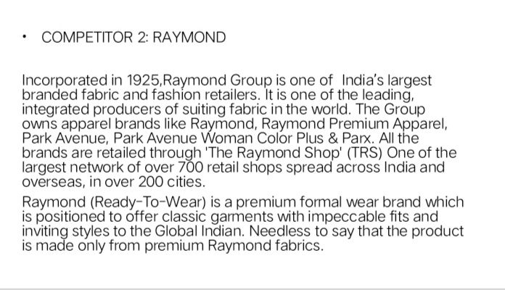

Slide 6
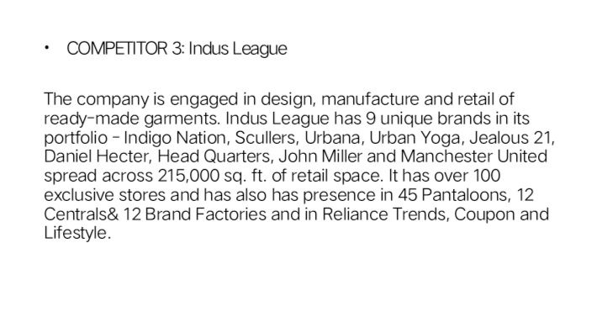

Slide 7

Buyer’s/ Audiences Personal
Flying machine is the first denim brand that India had. It make denim clothes, bags, shoes etc. for every gender. Flying machine focuses on people who are
Love fashion and make people fashionable.
Who are Indian product lover.
Highly dogmatic since these customers are more likely to prefer different outfits.

Slide 8
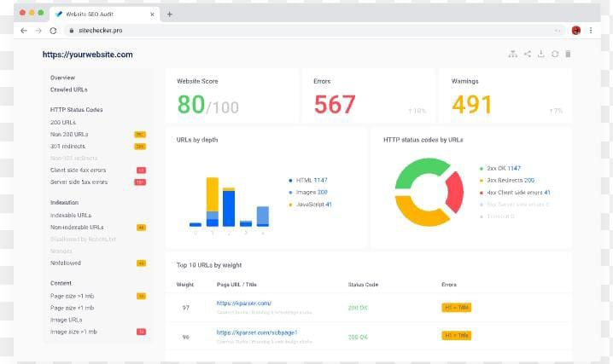
Part 2: SEO & Keyword Research
SEO Audit of flying Machine Website:

Slide 9

Keyword Research
Flying Machine Research Objectives:
Students dream up and draw their own design for futuristic and fanciful flying machines. They learn that doodling, sketching and brainstorming are related to the invention process and about early inventions.
Brainstorm Seed Keywords:
Seed keywords are word or phrases that you can use as the starting point in a keyword research process to unlock more keywords. Think of them as the building block of keywords research.

Slide 10
Key Word Research Tools:
SEMRUSH
Analysis of competitor keyword
Madura Garments
Raymond
Indus league
Flying Machine. Com competitors and alternatives
# Madura Garments. Com
visits: 123,471
# Raymond. Com
Visits: 1,142,223
# Indus league
Visits: 241,331

Slide 11
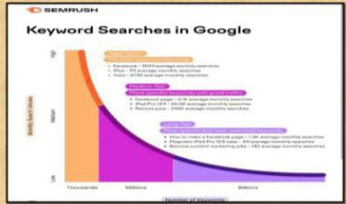
Long- tail Keywords:
For example, if we analyse the keyword “best content marketing podcasts,” we see that it has a low search volume and low keyword difficulty and also have lower competition but higher conversation potentially which align with the research objectives. It’s also longer and highly specific. So, it’s a long-tail keyword. These are usually keywords closely related to the term you just searched for.

Slide 12

One tag optimization: META TAG OPTIMIZATION
Meta tags are HTML, tags used to provide additional information about a page to search engines and other clients. Clients process the meta tags and ignore those they don’t support. Meta tags are added to the <head> section of your HTML page and generally look like this: <!
Meta Description for SEO
Keep it under 160 characters.
Create distinct summaries for each page.
Avoid duplicate meta description on your websites.
Use sentence case.
Be accurate, descriptive and concise.
Match search content.
Only include your target keyword where it makes sense.

Slide 13
CONTENT OPTIMIZATION FOR SEO:
Essentially content optimization, or SEO ( Search Engine Optimization) is the process of optimizing your content to make sure that it’s more visible through the web. Search engine robots will rank highly optimized content higher on a search engine page than non-optimized content.
TIPS AND TECHNIQUES HOE TO OPTIMIZE:
Write great content.
Keep new content coming.
Use headings.
Optimize the text.
Optimize images.
Optimize videos.
Stop writing for search engines.
Use social media.
Keep it clean.

Slide 14

PROCESS OF CONDUCTING KEYWORD RESEARCH AND THE SEO RECOMMENDATIONS:
Keyword research is the process of finding and analysing keywords your ideal website visitors enter into search engines that enables you to target the most effective keywords in your content strategy. Keywords are words or phrases people use to find information or products in search engines. For example, if you want to buy food for your puppy you might type the keyword food for puppies into Google properly conducted keyword helps you to:
Better understand your niche and target audience.
Tailor your content strategy to the needs of your audience.
Get more relevant traffic to your website.

Slide 15

In this guide, we’ll cover three steps of keyword research:
Finding keywords: How to find relevant keywords with keyword research tools.
Analysing keywords: How to prioritize keywords using key metrics and criteria.
Targeting keywords: How to identify primary keywords and nail their search intent.

Slide 16

Challenges faced during the research and analysis phase, as well as the key insights gained from the keyword research process.
What is Keyword Research?
Keyword research is the process of identifying which queries customers use to guide their search journey and lead them to relevant information.
To help, Google provides a free tool called the Google keyword Planner for Google Ad Words users that assign a monthly search volume estimate for keywords phrases(groups of keywords clustered together) to help researchers. It also provides keyword suggestions to find more potential targets.
But SEO clarity users can review the largest keyword data set available: 30+ billion keywords across +170 countries, and updated weekly!

Slide 17

Why is Keyword Research Important?
Keyword research allows you to discover terms related to a certain topic and uncover their search demand, difficulty score, intent and more.
From there, you can create based on those words and topics, and get in front of your target audience by appearing on the Google search engine results pages (SERPs) with the content you know they’re looking for.
You can’t create content on a whim and hope that it performs well- you need to create data- supported content that you know will perform properly for the right target audience.
This is where keyword analysis goes hand-in-hand with research.

Slide 18
Why Research and Analyse Keywords?
A} Prioritize keyword opportunities. Not all phrases you discover during the research can, in fact, drive significant traffic or rankings. Or their popularity is seasonal and there is no need to work on them now. Keyword analysis allows you to prioritize opportunities so that you always work on the ones that can deliver the highest ROI.
B} Learn more about the audience’s preference. Analysing keyword data like the search volume or CPC cost will reveal a lot about what engages the audience. You will also discover which keywords are the most relevant to you audience( and why).
C} Evaluate the competition. Keyword analysis uncovers who else targets the keywords, and how likely you are to beat them( or what you need to do in order to beat them).
D} Analyse current keyword’s performance. The process will also reveal the reasons why certain pages do not perform well for their target keywords, and highlight ways to overcome the issue.

Slide 19
How to do Keyword Research as Part of Your SEO Strategy?
Now that I’ve outlined the need-to-know concepts above, we can divide into details of how to actually conduct your research.
The process I’ve outlined below are ones I use personally and recommend to our clients. It will help you identify head terms to target, long-tail keywords to drive targeted traffic and create the content that will help you achieve your goals.
Our process includes five easy-to-follow steps:
Identify the most relevant topics.
Match topics with seed keywords (or head terms).
Research more deeply in line with your core topics.
Refine those keywords to identify the biggest opportunities.
Prioritize keywords to focus on first.

Slide 20
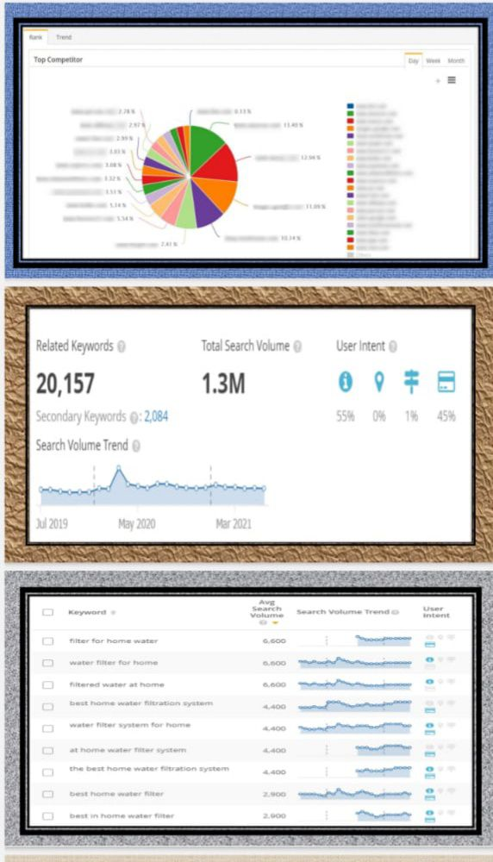

Slide 21
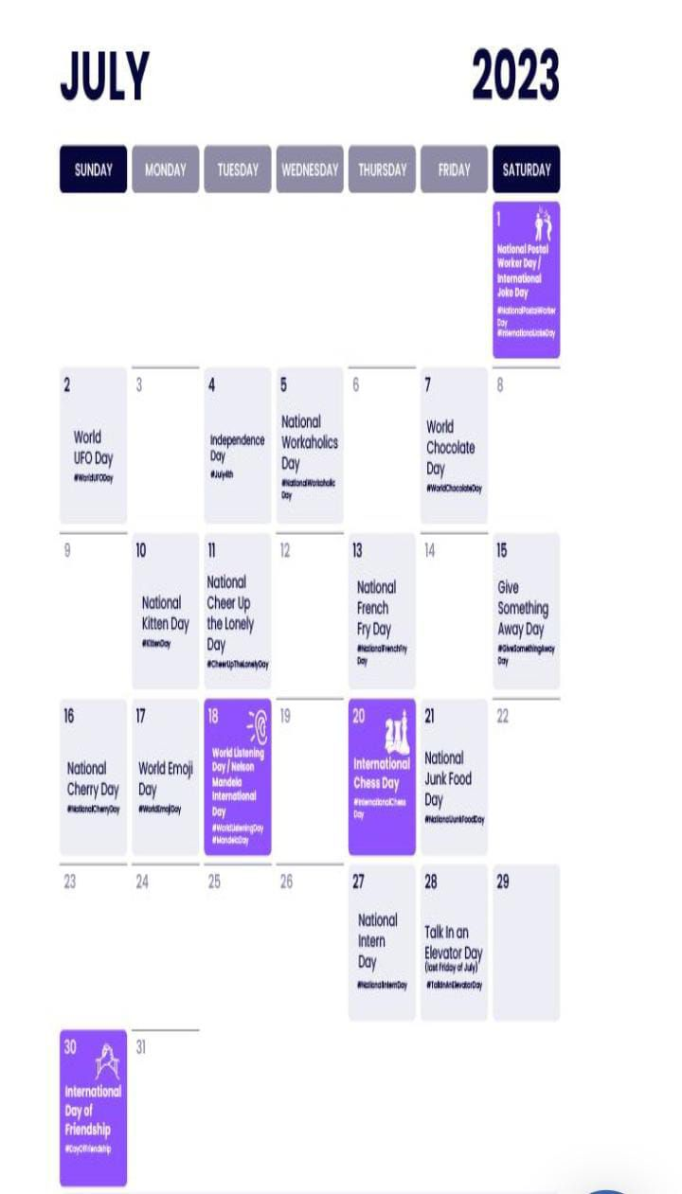
Part 3: Content ideas and marketing strategies
Content calendars
July 2nd: “ Different printed collection”
At the occasion of world UFO Day flying machine makes different printed collection for youth
From July 2nd to July 6th
July 7th: “Anything is good if it’s like chocolaty”
In these day flying machine makes lots of offers in clothes and bags for families.
From July 7th to July 9th
July 10th: “ Be with flying machine”
There are 15% off in any clothes of ladies and gents.
From July 10th to July 14th
July 15th: “ You can’t away anything from flying machine”
There are 50% off at each product and which are comfortable for you.
From July 15th to July 29th.
July 30th: “Give something to your best friend”
Flying machines make lots of clothes for your best friends

Slide 22

STRATEGY, AIM AND THE IDEA BEHIND THESE POSTS AND STORIES
Ensures consistency:
Content calendar lays out all your marketing activities including past, present and future, so you can better see how each activity relates to the others. This features allows you to plan a more consistent schedule of activities- and make sure that they all work together to build your brand.
A content calendar is a resource to plan, schedule and organize content creation and publishing. Marketing teams rely on their calendars to plan campaigns across different platforms- like the company’s blog, email marketing and social networks.
A content calendar is important to keep your content marketing well-organized and on track. It helps you with initial brainstorming, which saves you from last-minute disastrous planning and helps you produce content consistently.
A social media calendar lets you plan ahead, batch your work, avoid multitasking and note down all your content ideas for later. Social media planning calendar tools even allow you to schedule social media posts ahead of time.

Slide 23

Content, Ideas & Marketing strategies process
Adopt a unique angle with your content. Know your Audience.
Tap into current trends.
Build evergreen content.
Nurture your email subscribers.
Create original research.
Write your case studies.
Build interactive tools.
Testimonials and Reviews.
Repurpose content.
Update old content.
Encourage user-generated content.
Guest blogging.
Create videos on social media.
Host a podcast.

Slide 24
Challenges encountered and lessons learned in marketing strategies
Recruiting talent.
Maintaining a sufficient budget.
Generating leads.
Finding the right tools.
Being risk-averse.
Moving into new markets.
Retaining customers.
Retaining and training staff.
Choosing effective tactics.
Facing increased competition

Slide 25



Part 4: Content creation and curation
Post creation

Slide 26


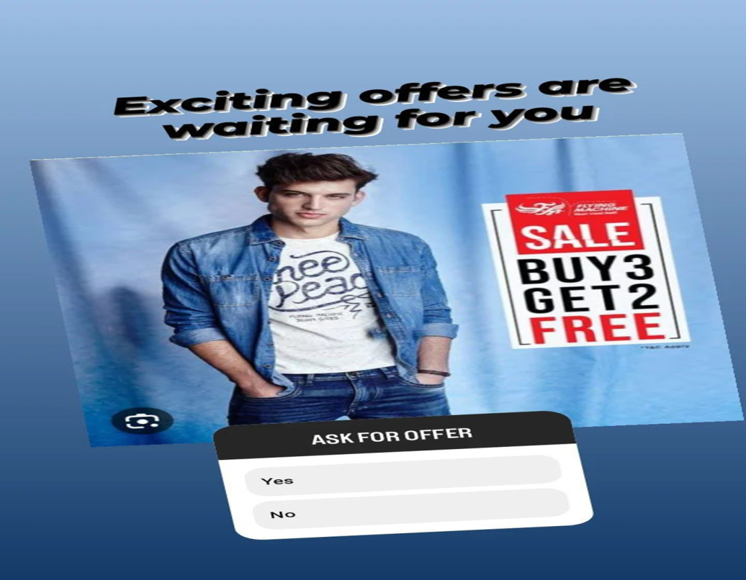
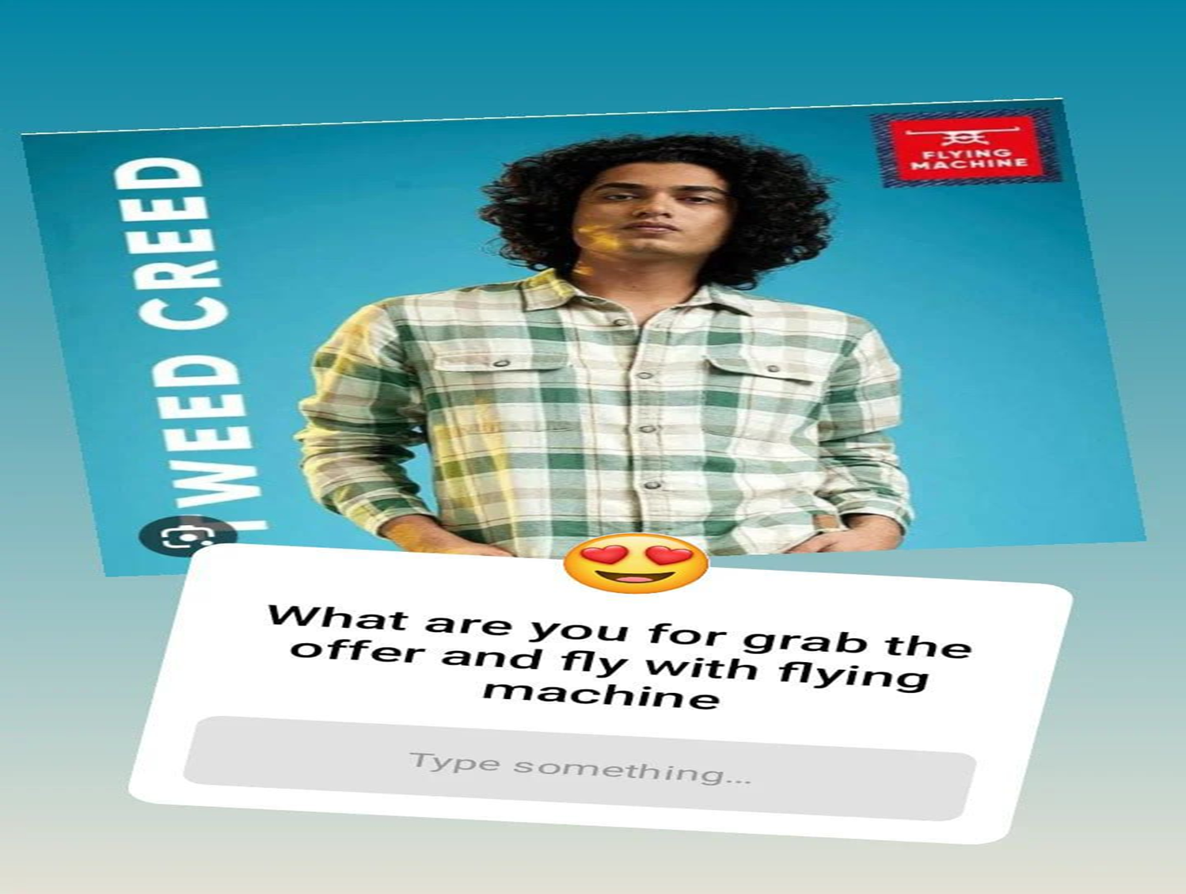
Instagram Story

Slide 27
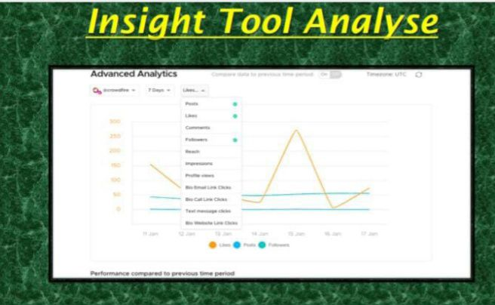

Slide 28
Strategies and Areas for Improvement
Redefine your marketing strategy as per your goals.
Create/ hire your digital marketing team.
Focus on SML.
Create multi-channel campaigns.
Develop an exceptional content creation strategy.
Optimize the content.
Rely on automation.
Continuous improvement is the key.

Slide 29

Design/ video editing

Slide 30

Video Creation

Slide 31
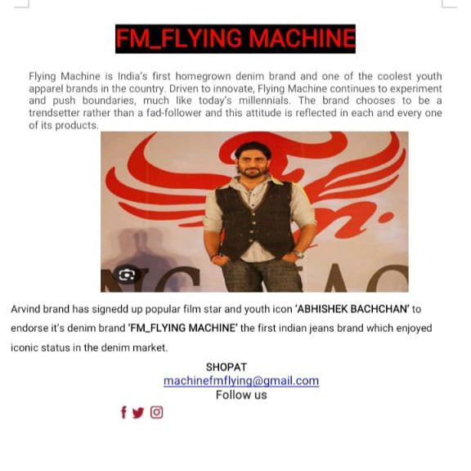
Email ad campaign 1: Brand awareness

Slide 32

Email ad campaign 2: lead generation
Save your Pockets with these amazing flying machine offers.
Are you searching for Indian made branded clothing? Your search ends here! Flying machine is India’s very own denim brand, offering a wide range of men’s and women’s apparel at extremely low prices.
Buy any clothes for Rs. 5999 and get free shopping worth Rs. 1000
SHOPAT
machinefmflying@gmail.com
Follow us

Slide 33
Advertising Goals:
BRAND AWARNESS:
Brand awareness refers to the familiarity of consumers with a particular product or service. Social media has become an important new tool in brand awareness marketing.
Driving Website Traffic:
Website traffic refers to web users who visit a website. Web traffic is measured in visits, sometimes called “Sessions” and is a common way to measure an online business effectiveness at attracting an audience

Slide 34
Generating leads:-
Lead generation is the process of generating consumer interest for a product or service with the goal turning that interest into a sale.
Audience targeting:-
Your target audience refers to the specific group of consumers most likely to want your product and services, and therefore the group of people who should see your ad campaign. Target audience may be dictated by age, gender, income, location, interests or a myriad of other factors.
Target demographic include information about your audience’s age, gender, income, location, interests, religion, education, family, size and other measurable and observable characteristics.
Visually appealing ad compelling ad copy and relevant call to action.

Slide 35

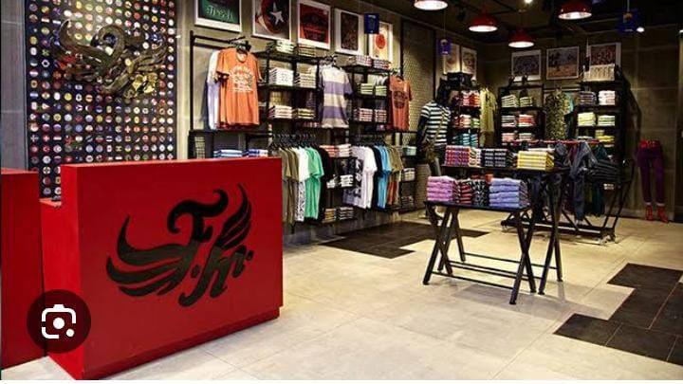

Visually appealing ad compelling ad copy and relevant call to action.

Slide 36


